Slide 1
Introduction to Bioinformatics
Biology is Data

Slide 2

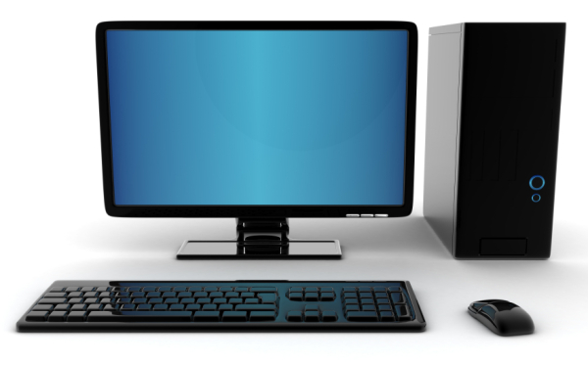
What is a computer?
A computer is a general purpose device that can be programmed to carry out a finite set of arithmetic or logical operations. Since a sequence of operations can be readily changed, the computer can solve more than one kind of problem.
- http://en.wikipedia.org/wiki/Computer- retrieved April 23rd 2013

Slide 3
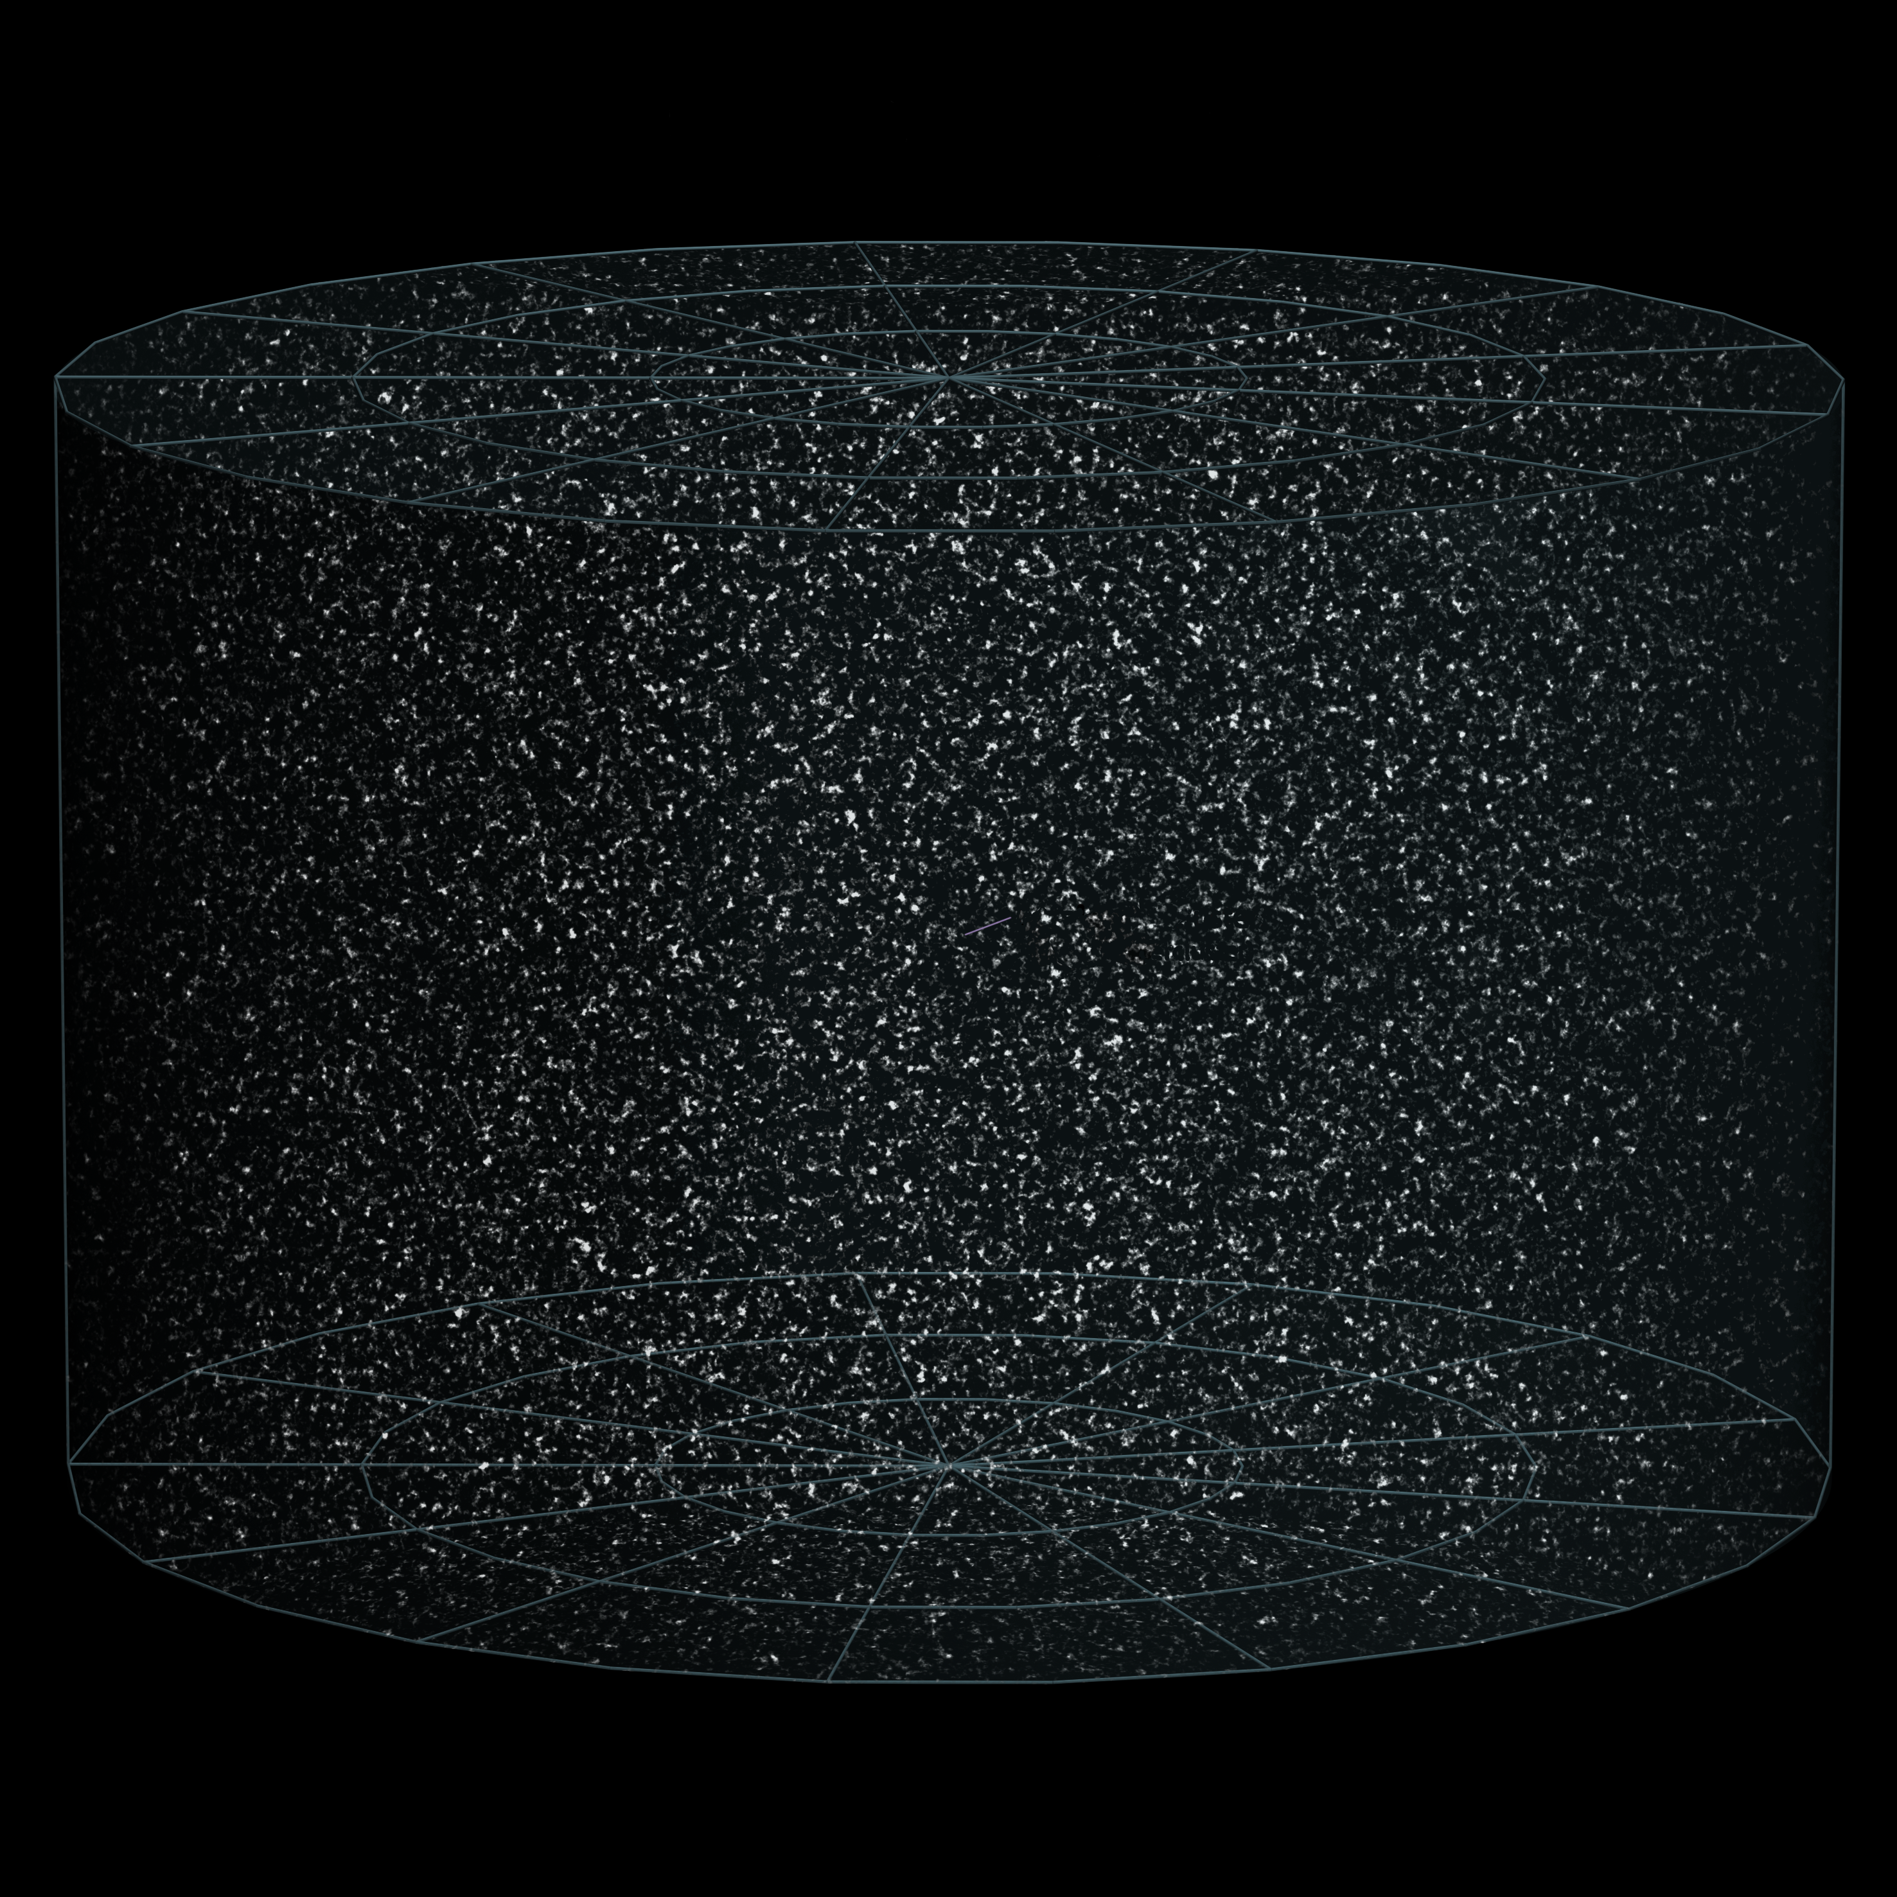
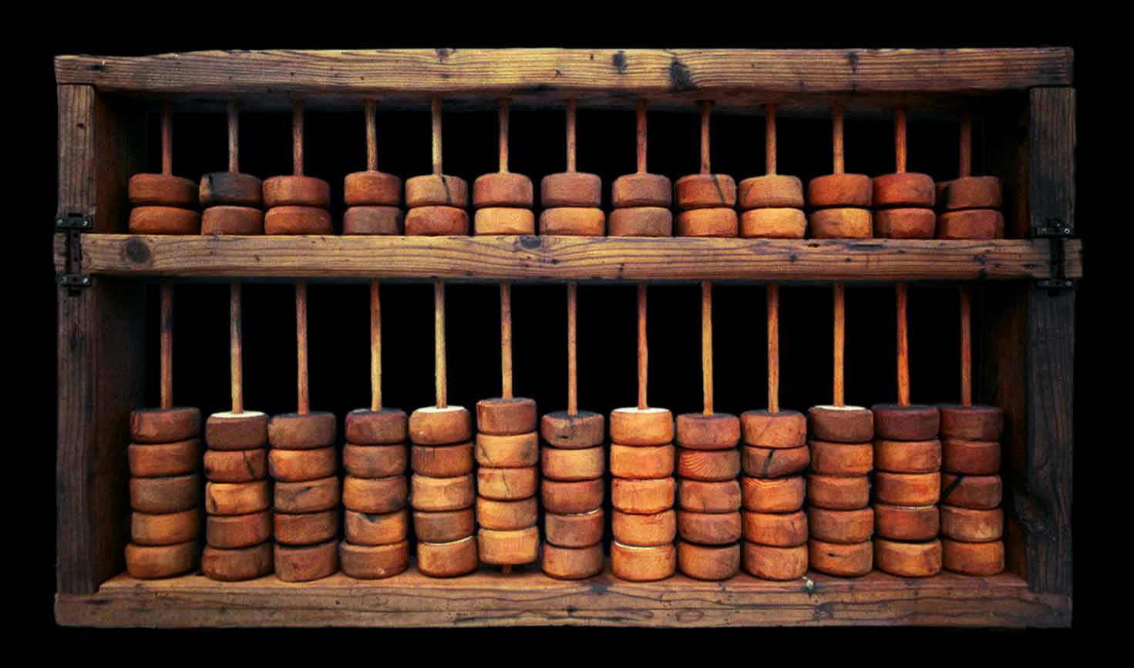
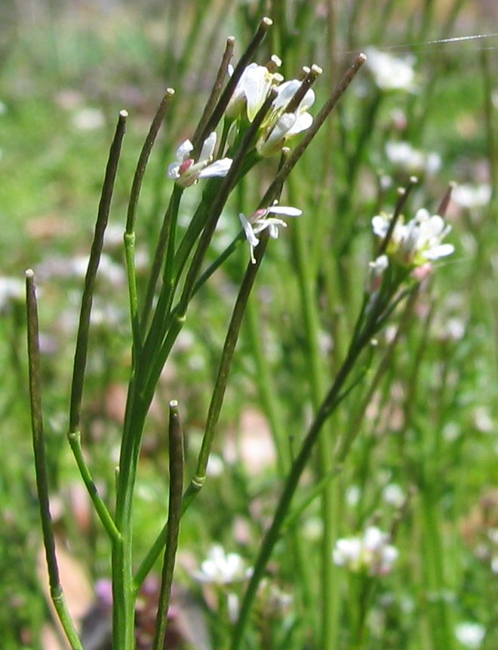
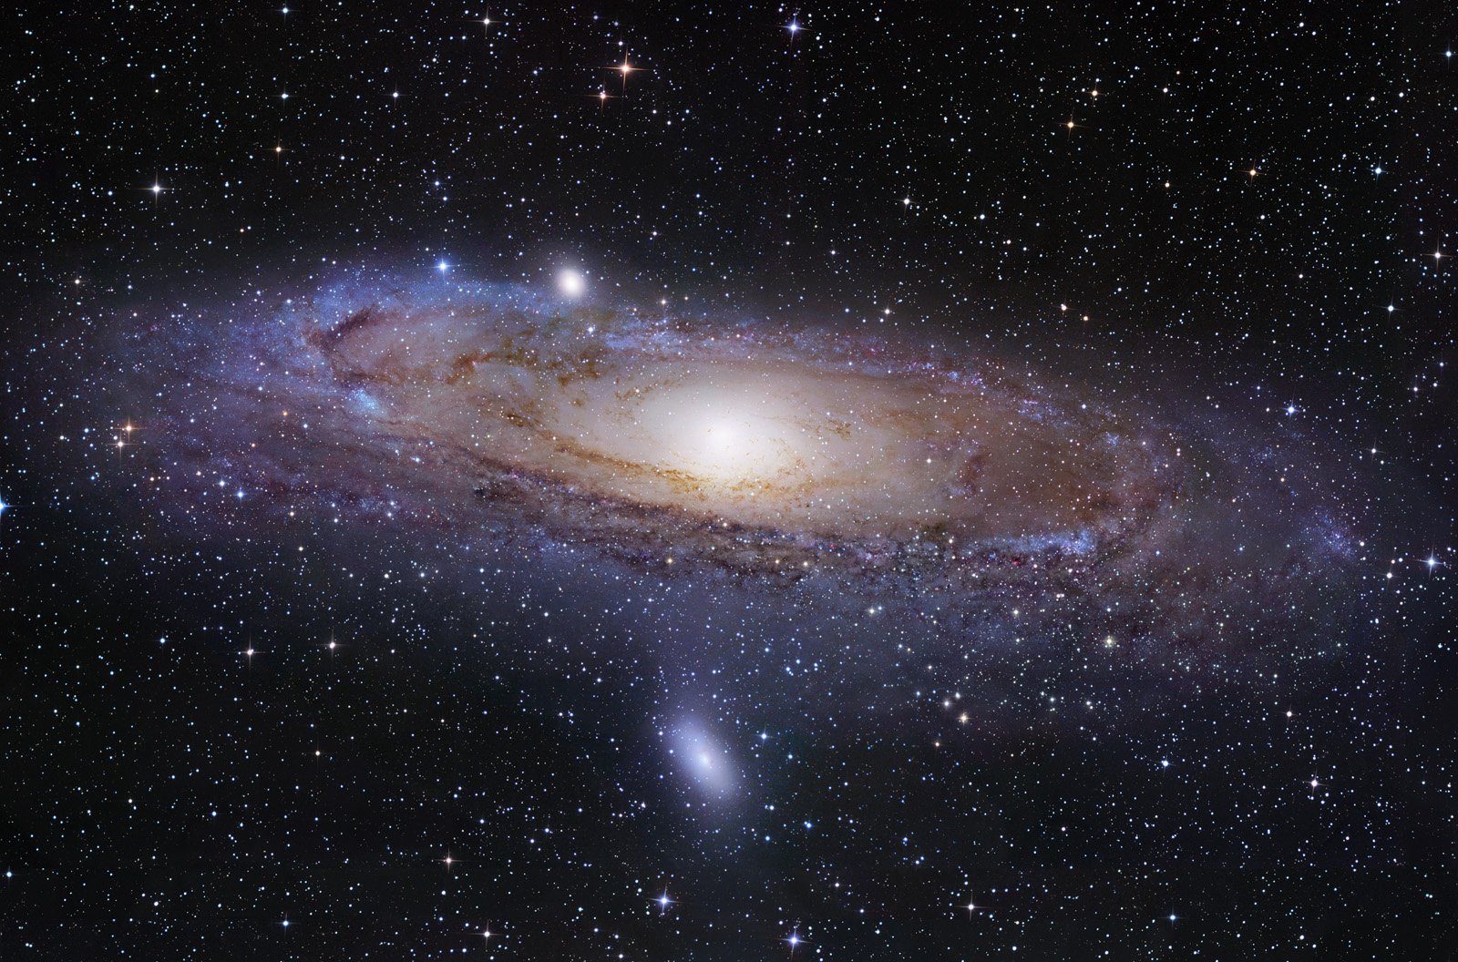
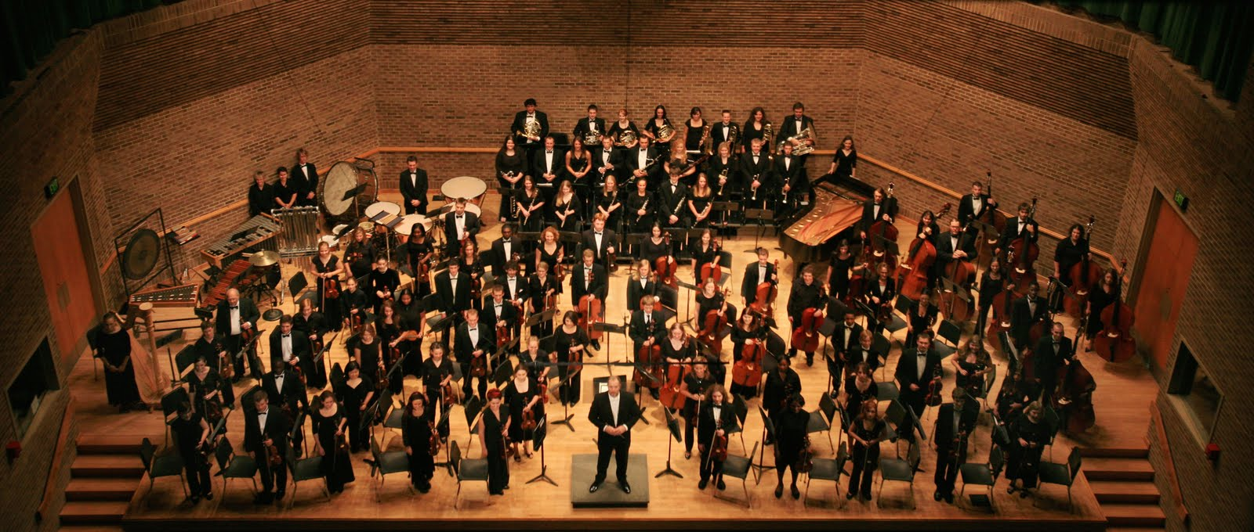
What is a computer?
an Abacus
the Universe
A. thaliana
an Orchestra

Slide 4
What is a computer?
✗
?
an Abacus
✓
✓
the Universe
A. thaliana
an Orchestra

Slide 5
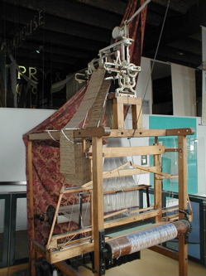
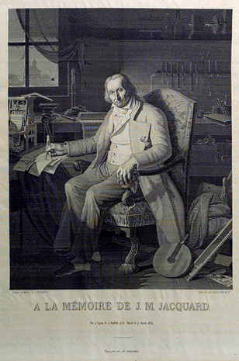
What is a computer?
The Jacquard Loom
c. 1801

Slide 6
What is a computer?
The Jacquard Loom
c. 1801

Slide 7
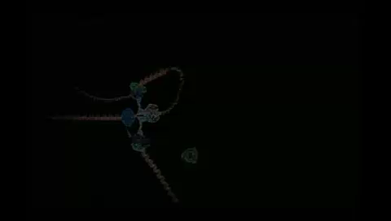

What is a computer?

Slide 8
What is Bioinformatics?
In biology, Bioinformatics /ˌbaɪ.oʊˌɪnfərˈmætɪks/ is an interdisciplinary field that develops and improves upon methods for storing, retrieving, organizing and analyzing biological data. A major activity in bioinformatics is to develop software tools to generate useful biological knowledge.
- http://en.wikipedia.org/wiki/Bioinformatics - retrieved April 23rd 2013

Slide 9
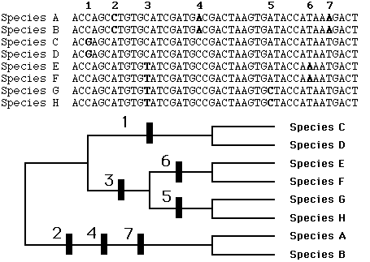
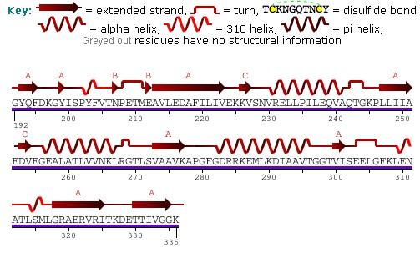
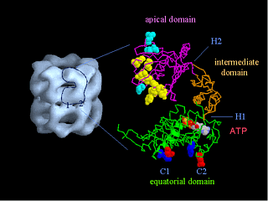
What is Bioinformatics?
sequence and structure of HSP60
a Phylogeny of 8 species
http://people.cryst.bbk.ac.uk/~ubcg16z/hsplec.html

Slide 10
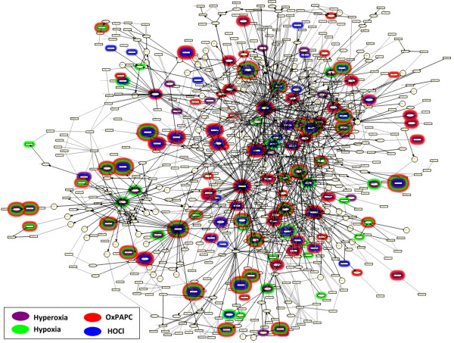
What is Bioinformatics?
The Cellular Stress Network.
Highlighted nodes are Reverse
Causal Reasoning (RCR) hypotheses,
predicted to have increased or decreased
abundance or activity, in the indicated
cell stress data sets.
Schlage et al. BMC Systems Biology 2011 5:168 doi:10.1186/1752-0509-5-168

Slide 11
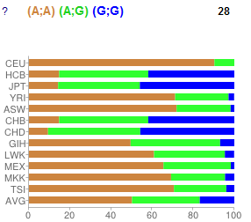
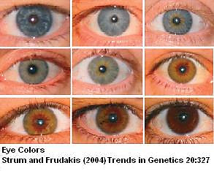
What is Bioinformatics?
A;A Blue/Grey more likely
A;G Blue/Grey less likely
G;G Blue/Grey less likely
There are very few “always” statements in biology; very few unbreakable rules
To draw useful conclusions hypotheses, data may need to span many
individuals, time points, and scales

Slide 12

NCBI Quick Tour
NCBI Homepage https://www.ncbi.nlm.nih.gov/
Human Genome: https://www.ncbi.nlm.nih.gov/projects/genome/guide/human/index.shtml
Corona Virus Genome: https://mra.asm.org/content/9/11/e00169-20

Slide 13
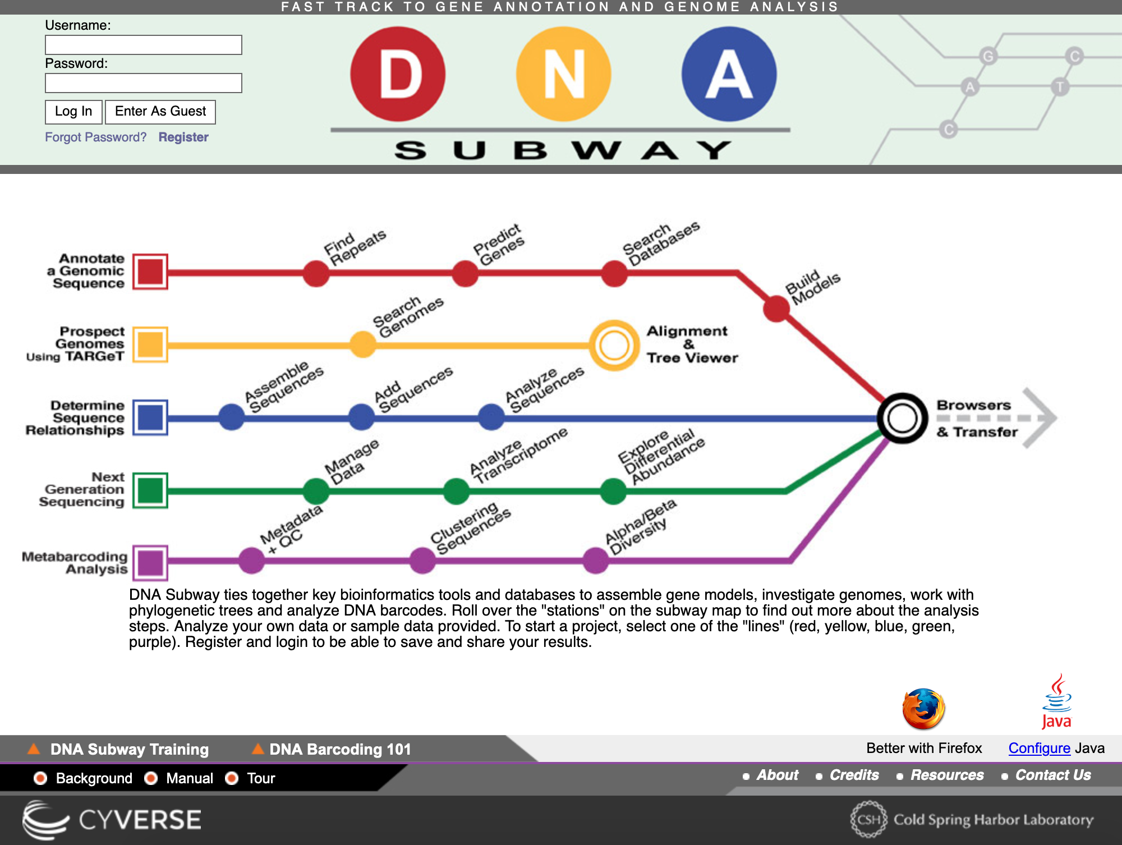
Mitochondrial DNA analysis using DNA Subway

